Slide 1
Pre-MTAC Webinar
United States Postal Service
October 15, 2019

Slide 2
Topics
Seamless Acceptance
Mail Irregularities
Enterprise Payment System (EPS)
Business Customer Gateway (BCG)

Slide 3
Seamless Acceptance

Slide 4
Seamless Acceptance
Seamless Expectations
Mailers with letter and flat sized mailpieces that are Full-Service eligible and currently rely on a special postage payment system such as Manifest, Optional Procedure or Combined Mailings
Will no longer require these authorizations in the Seamless environment
While the piece information must be documented by electronic documentation, we will validate postage and presort using the Seamless validation processes
Detached Mail Unit (DMU) Mailers
Will continue to operate as a DMUs under Seamless, however, will no longer require the observation of loading or sealing USPS provided transportation, as eInduction is a requirement under Seamless
USPS employee(s) will be onsite to perform Seamless samplings
The mailer can expect a reduced USPS presence at the DMU
If a mailer has additional volume not in Seamless (PMOD, certificates of mailing, etc.) that is currently verified/validated at a DMU, the local USPS will work with the mailer to provide continued support for those products.

Slide 5
Seamless Acceptance
Seamless FAQs
Seamless FAQ group meets bi-weekly
First session held 10/8 and we have produced a list of FAQ’s for all sizes and types of mailers
USPS to work on completing answers and share with Industry group – expected completion for first draft 10/29

Slide 6
Seamless Acceptance
Federal Register Notice – Proposed
Posting in October 2019 with 30-day comment period*
Seamless mandate for DMUs and 90% Svc BMEU entered
Seamless Parallel by March 1, 2020
Seamless by February 1, 2021
Retirement of manual verifications for mailers submitting over 90% Full Service volume by July 1, 2021
Auto-finalization of Seamless postage statements, even if permit fees are due for renewal
*Pending outcomes of discussions

Slide 7
Informed Delivery Promotion
We Will Provide Further Updates on the Seamless FRN & the Flats Process at MTAC
on
Placeholder – Need to create slide announcing session during MTAC
Wednesday, October 30th

Slide 8
Mail Irregularities

Slide 9
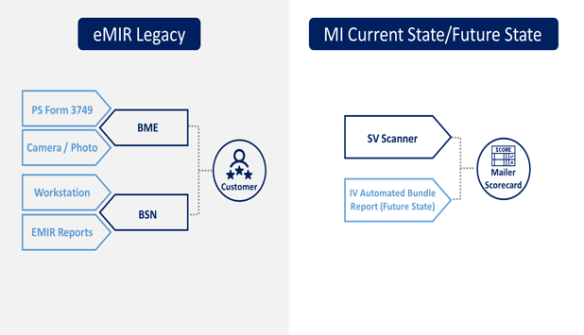
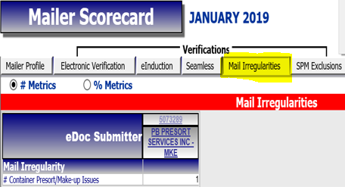
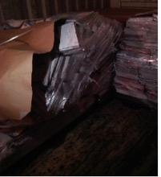
Mail Irregularities
January 2019 - Deploy MI Tab to Mailer Scorecard (Internal)
February 2019 - BMS MI Internal Testing Completed
March 2019 - External Mailer Testing Completed
May 2019 - Internal MI BME Field Training
Sept 25th 2019 - IV Automated Bundle MI Added to Internal tab of Mailer Scorecard
Sept 25th 2019 - BMS testing of IV Automated Bundle MI
TBD Pilot External Mailer Testing of IV Automated Bundle MI
TBD External Display MI Tab of Mailer Scorecard

Slide 10
Enterprise Payment System (EPS)

Slide 11
Enterprise Payment System (EPS)
Key Metrics & Timeline
$4.6M in FY19
$5.2M Overall
in Mobile Deposits
66,199 93%
Eligible CAPS Permits Migrated
78K
Migrated PO Boxes
$18.1B
in Revenue Collected Overall
3/17/2019
Add true up feature (regular interval) to EPOBOL
6/9/2019
iCAPS
Sharemail
8/2019
eVS available on EPS
8/2020
Commercial Postal Store

Slide 12
Enterprise Payment System (EPS)
eVS Products on EPS
Supported Products
Click-N-Ship Business Pro (CNSBP)
Scan Based Payment (SBP) and Merchandise Return Service (MRS) customers are being migrated to the Package Platform which is supported by EPS
Unsupported Products
Parcel Return Service (PRS)
Premium Forwarding Service Commercial (PFSC)
Third Party Billing
Package Intercept

Slide 13
Enterprise Payment System (EPS)
To Onboard to EPS, eVS Customers Should…
Identify a migration point of contact within your company that will work with USPS personnel
Identify active products and services to be migrated
Work through the migration process with your assigned eVS analyst
After successful onboarding, reach out to your assigned eVS analyst with any questions, concerns, or issues regarding your EPS account
eVS on EPS
As of August 2019, eVS customers are now eligible to pay for their products and services through the Enterprise Payment System (EPS) using either a Trust or ACH Debit account
Additional eVS to EPS onboarding details will be provided when available

Slide 14
Business Customer Gateway (BCG)

Slide 15
Business Customer Gateway (BCG)
Phase 1
Phase 2 (Planned)
New BCG User Interface & Style
Streamlined Navigation To Services
BCG Widgets
Enterprise Payment System
Mailer Scorecard
Recent Mailings (PostalOne! Dashboard)
Account Management Enhancements
Ability to Revoke and Archive Access
Additional BCG Widgets
Informed Delivery
Informed Visibility
Package Platform Scorecard
Address Verification for CRID Creation
Implementation of Task Team & Pilot Group Feedback
Pilot Link
-A separate prototype link will be provided to testers
-Pilot testers will still be able to access the old BCG
-Pilot group availability is limited
The pilot phase will give customers the opportunity to test and provide feedback on the new BCG
Pilot Launches 2020

Slide 16
Business Customer Gateway (BCG)
Leider and his team are actively working to resolve account management issues
We will provide an update on the ability to remove user profiles from a BCG account at MTAC at the end of October

